Slide 1

Social Media Management
Social Data mining Technique

Slide 2
Team members And Roles
Yogesh Vohra: Data Modeling
Darp Barot:
Developer and DBA
Sahil Grover: Business Analyst and Developer

Slide 3
AGENDA:
Process Iteration
Explanation of each process
Web scraping
Data Storage
Data visualization

Slide 4








Process
Search News Feed
Use web scrapping
Data Storing
Sentiment Analysis
Visualization
Data curation

Slide 5

1 - Search News Feed
We used rss feed of BBC NEWS and The New York Times to fetch the data.

Slide 6

Why choose BBC?
Authorized and up-to-date information
Meaningful and trustworthy data source
Data is well structured
Latest data

Slide 7

Why choose The New York Times?
Authorized and up-to-date information
Meaningful and trustworthy data source
Data is well structured
Latest data

Slide 8
2 - web scrapping

Slide 9
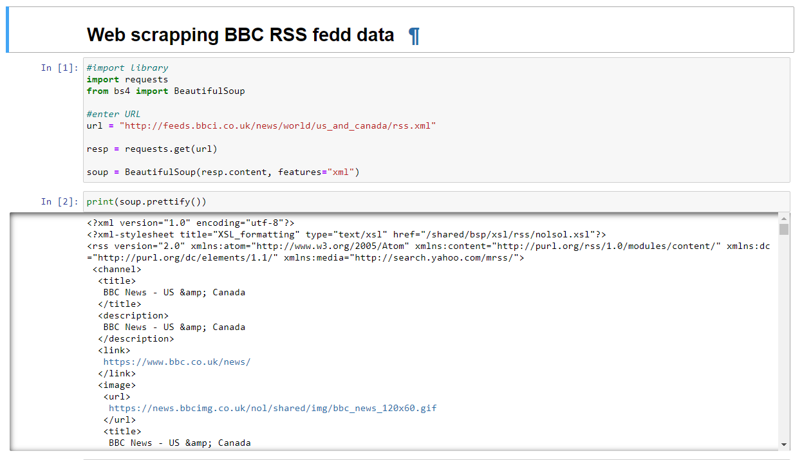
2 - web scrapping (The BBC NEWS)

Slide 10
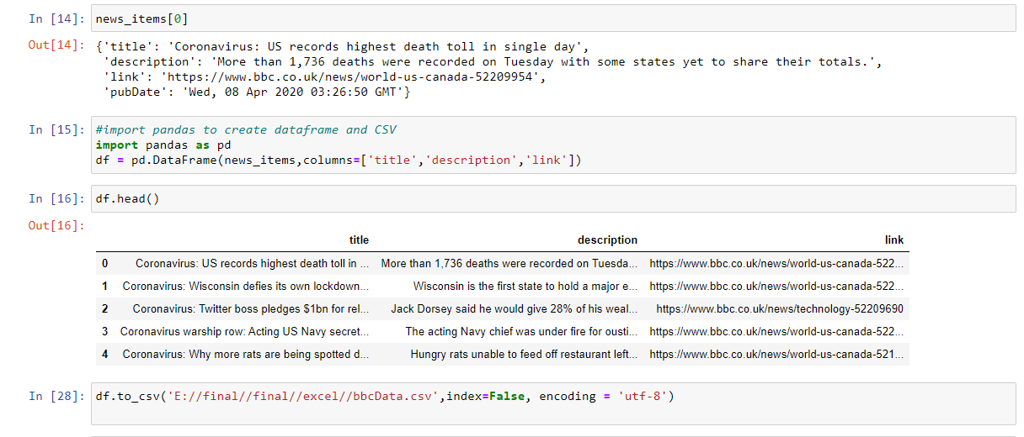

Slide 11
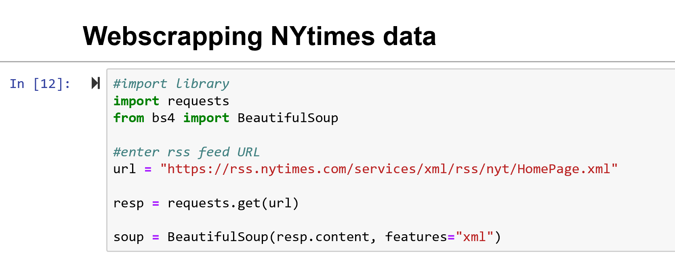
2 - web scrapping (The NY Times)

Slide 12
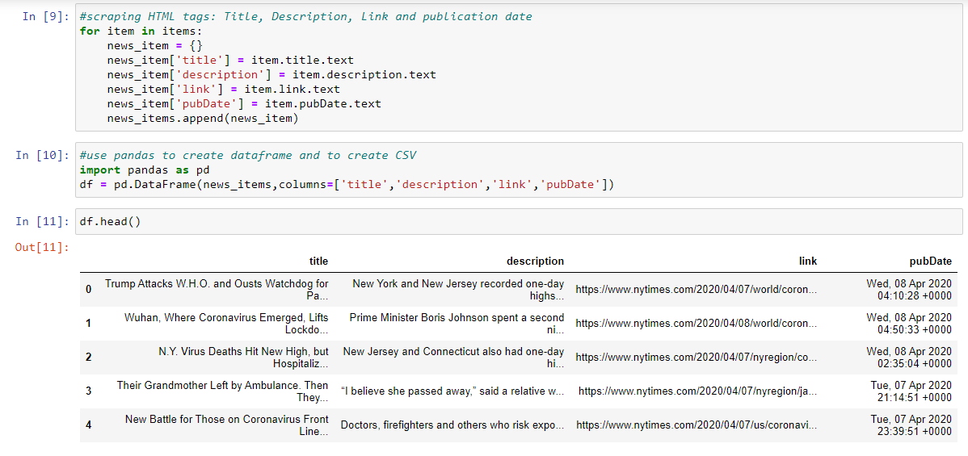

Slide 13
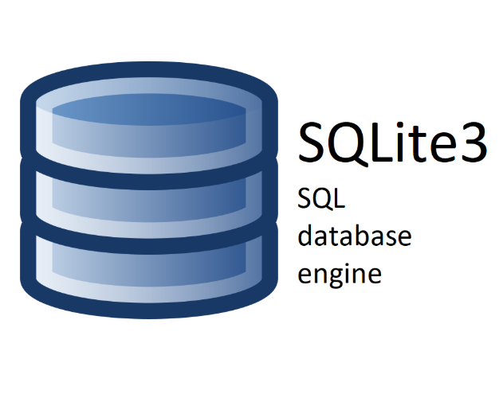
3 – DATA storing

Slide 14
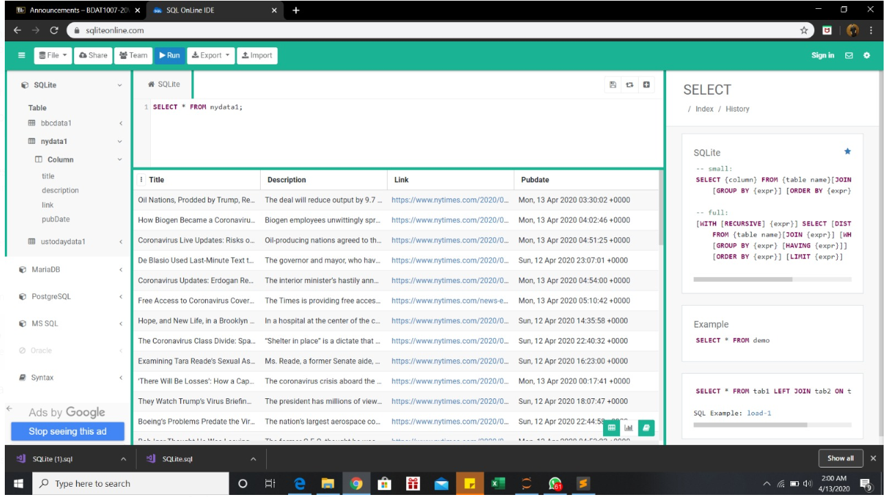

Slide 15
4- Sentiment Analysis

Slide 16

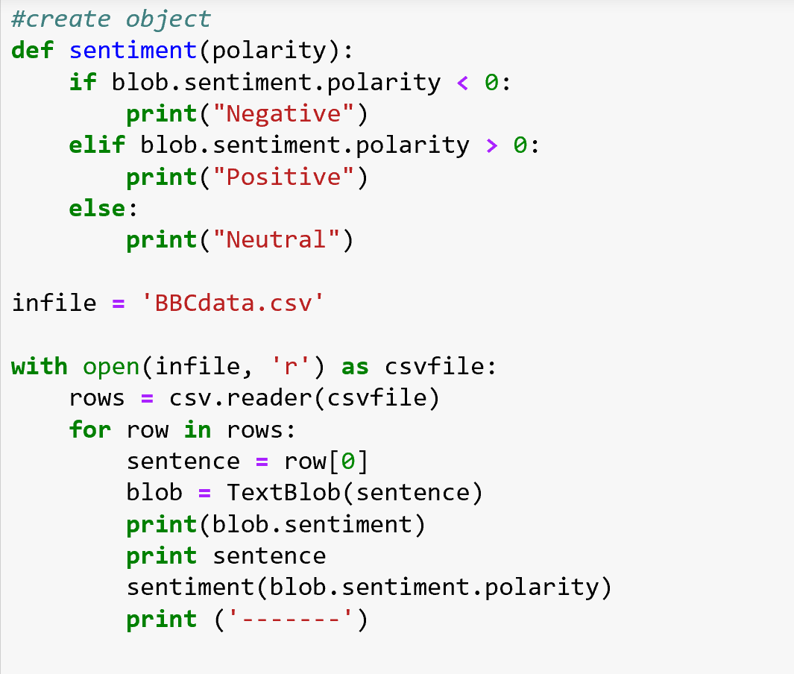
Create an object for status update according the Polarity value
Using python inbuilt function print the status, polarity and subjectivity

Slide 17

5- Data Visualization

Slide 18
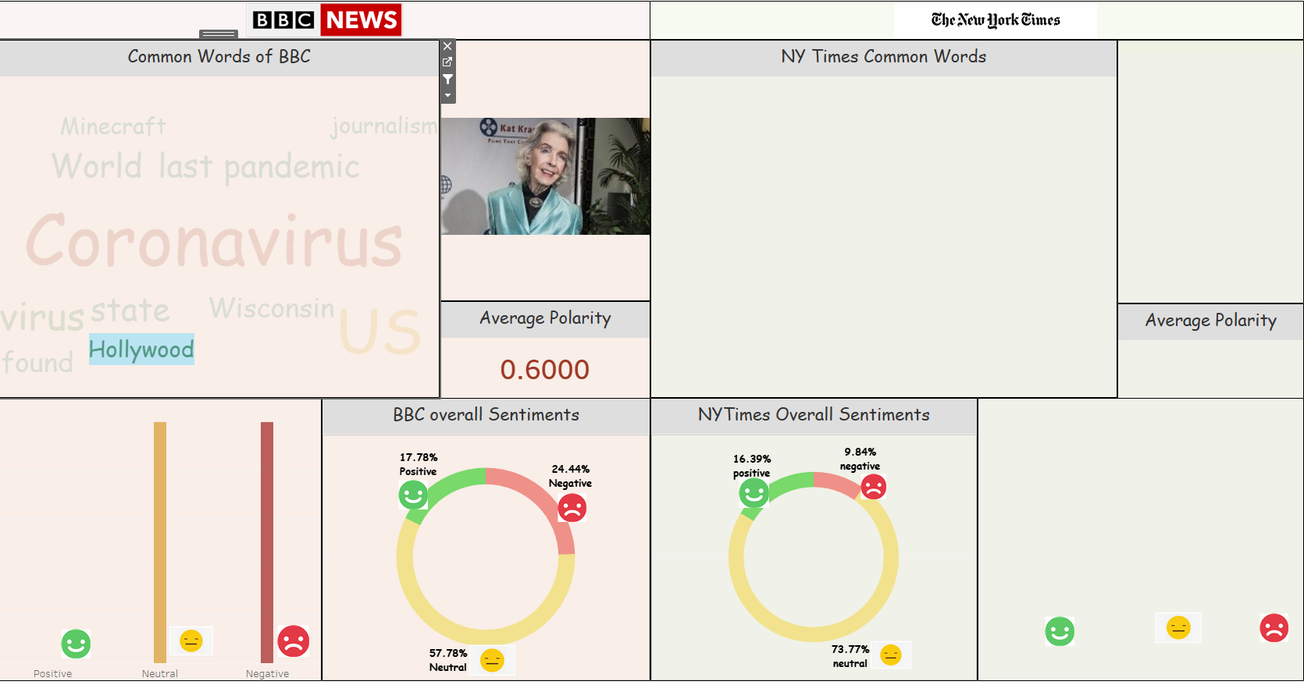
Dashboard

Slide 19
Demo Time

Slide 20
Link of YouTube:
https://youtu.be/syRg1zmBVDI

Slide 21
Thankyou

